Slide 1


International Conference on ICT Convergence
Lotte Hotel, Jeju Island, Republic of Korea
14–17 October 2025
#1571193797
6G-Enabled Digital Twin Framework for Real-Time Cyber-Physical Systems
Vaskar Chakma, Wooyeol Choi
School of Computer Science and Engineering
Chung-Ang University, Seoul, Republic of Korea
ICTC 2025

Slide 2


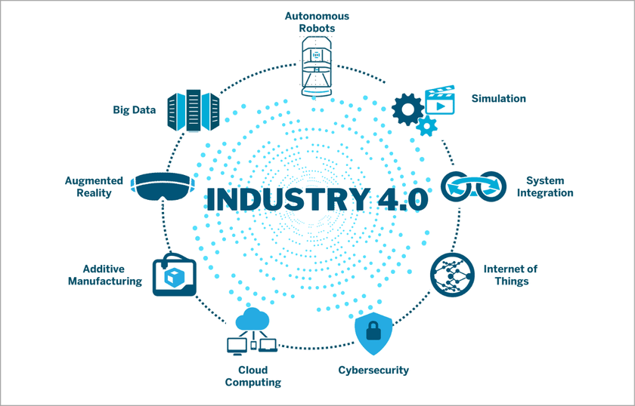
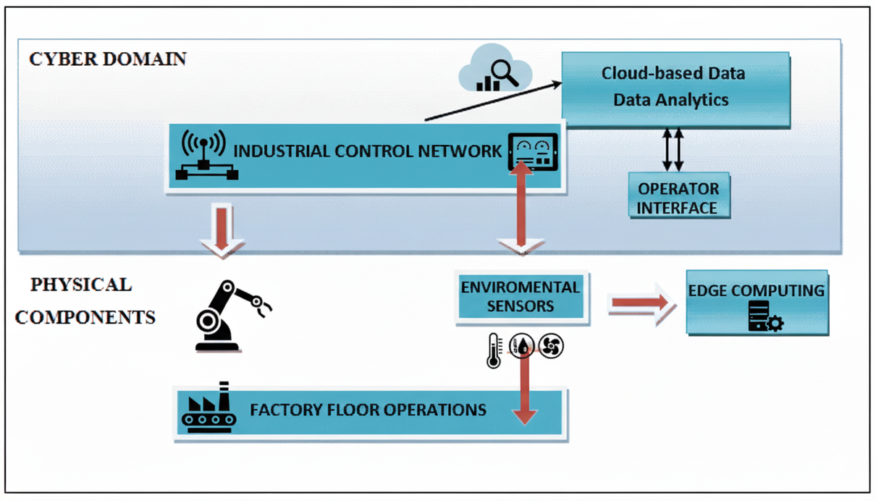

Cyber-Physical Systems (CPS)
What is Cyber-Physical Systems (CPS)?
CPS in simple terms:
It is a system where the physical world (machines, sensors, vehicles, medical devices, etc.) is tightly integrated with the cyber world (computation, networking, data, and control).
CPS enables real-time interaction between physical processes and computing/communication systems.
Essentially, CPS is the backbone of Industry 4.0 and emerging smart infrastructure!!!

Slide 3
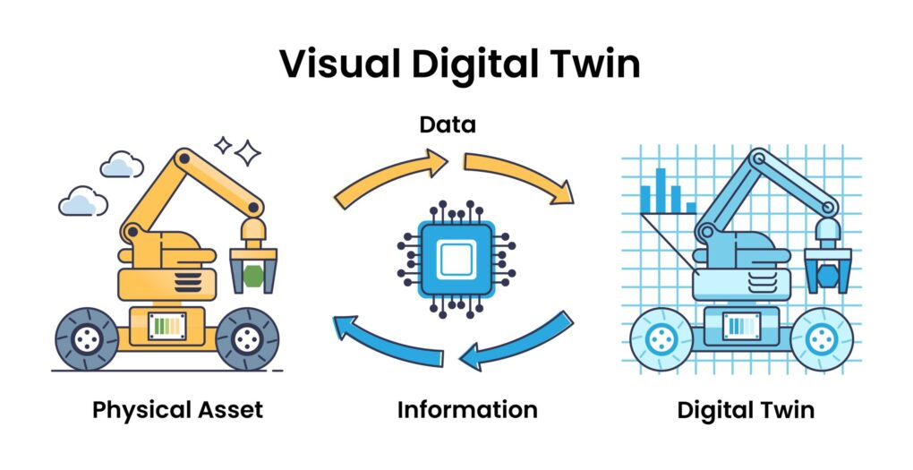
Digital Twin (DT)
What is Digital Twin (DT)?
A Digital Twin (DT) is a virtual replica of a physical object, system, or process that stays connected to its real-world counterpart through real-time data.
Key Points about Digital Twins (DTs)
A DT mirrors the physical system using data from sensors, IoT devices, and networks.
It allows real-time monitoring, simulation, and prediction of how the system behaves.
DTs can test “what if” scenarios virtually before applying changes to the real system.
They help with predictive maintenance, optimization, fault detection, and decision-making.

Slide 4















Proposed Framework
5-Layer Framework Architecture
CONTROL & FEEDBACK LAYER
Optimized control signals, bidirectional feedback, adaptive control, continuous improvement
DIGITAL TWIN CORE
High-fidelity simulations, real-time synchronization, predictive analytics, anomaly detection
EDGE INTELLIGENCE LAYER
AI/ML models, predictive maintenance, federated learning, local processing
COMMUNICATION LAYER
6G THz communications, IRS technology, network slicing, ultra-low latency
DATA ACQUISITION LAYER
IoT sensors, CPS devices, real-time data collection, preprocessing and normalization
Key Innovation: Seamless integration of 6G communication with edge intelligence for real-time bidirectional synchronization

Slide 5
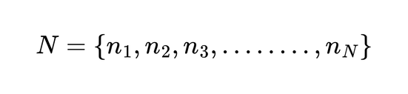
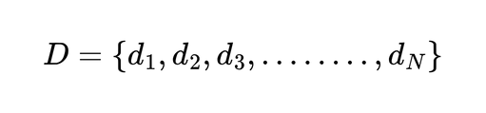
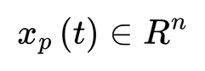
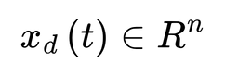
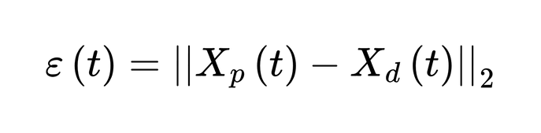
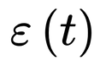
System Model & Notation
NETWORK ARCHITECTURE
Physical CPS Nodes:
Digital Twin Replicas:
STATE SPACE REPRESENTATION
(Physical System State)
(Digital Twin State)
SYNCHRONIZATION ERROR
Objective: Minimize
subject to latency constraints

Slide 6
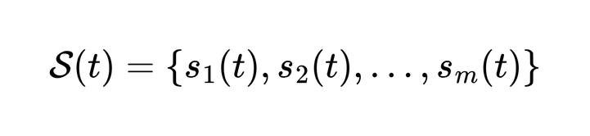
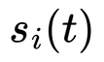
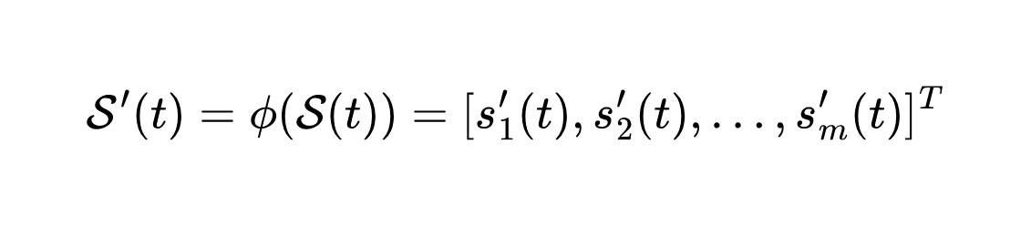
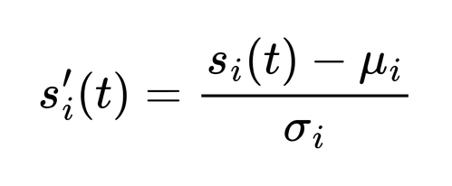


Data Acquisition Layer
SENSOR DATA COLLECTION MODEL
Where
represents the i-th sensor reading at time
t
PREPROCESSING FUNCTION
NORMALIZATION:
Where
and
are mean and standard deviation of sensor
i

Slide 7
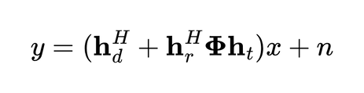
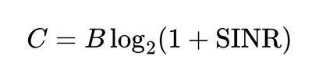
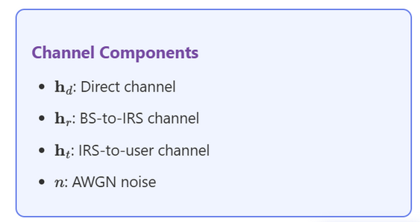
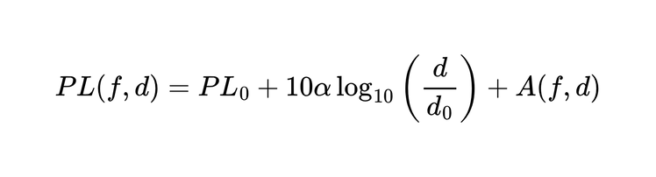
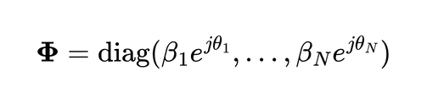
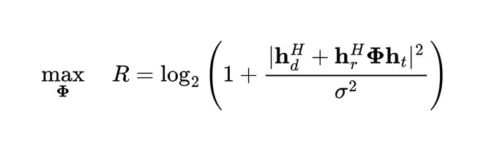
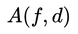
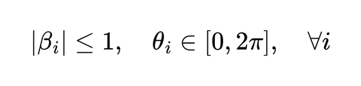
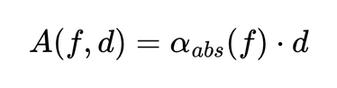
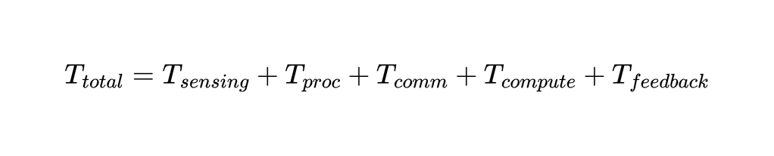
Communication Layer
Terahertz (THz) Communication
Intelligent Reflecting Surface (IRS)
Channel Capacity
Signal Model with IRS
Bandwidth B in THz range: 0.1-10 THz
Path Loss Model
Phase Shift Matrix
Components:
: frequency (THz)
: distance (meters)
: path loss exponent (2-4 for THz)
: molecular absorption loss
Optimization Problem
Molecular Absorption
Total Latency Decomposition

Slide 8
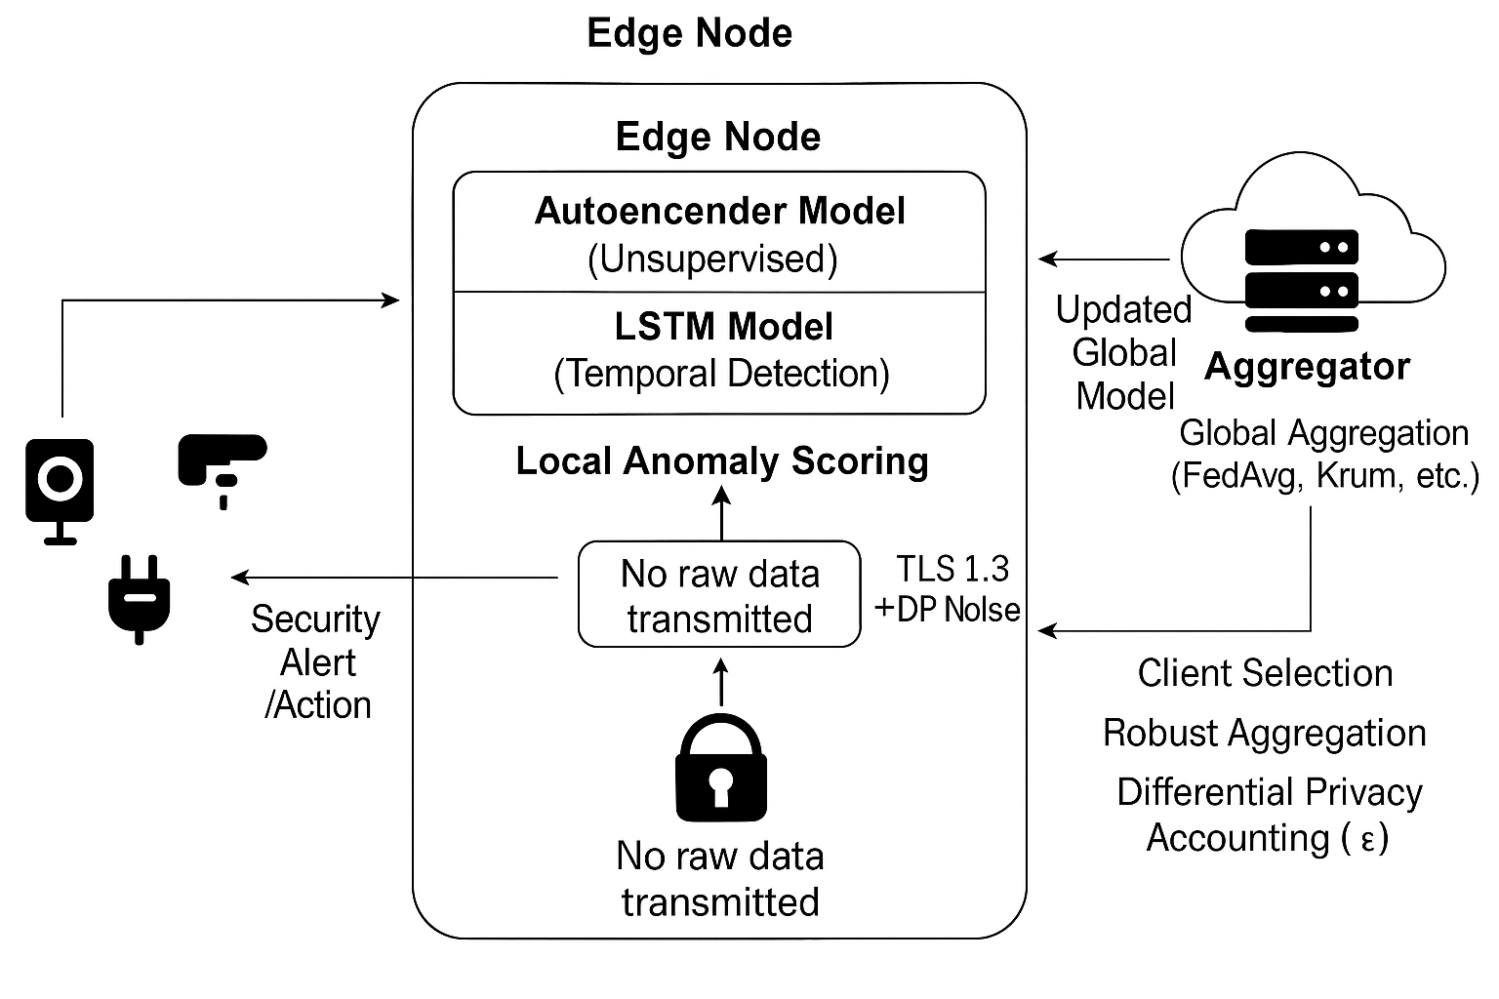
Edge Intelligence Layer

Slide 9
Performance Analysis
ICTC 2025
5G vs 6G Framework Comparison
Performance Metric | 5G Networks | Proposed 6G Framework | Improvement
End-to-End Latency | ~10 ms | ~1 ms | 90% Reduction
Data Processing | Centralized | Edge-based | Distributed
Synchronization | Periodic | Continuous | Real-time
Fault Recovery | Reactive | Proactive | Predictive
Learning Approach | Centralized ML | Federated Learning | Privacy-preserving
Scalability | Limited | Massive-scale | Enhanced

Slide 10
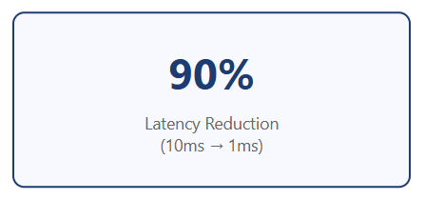
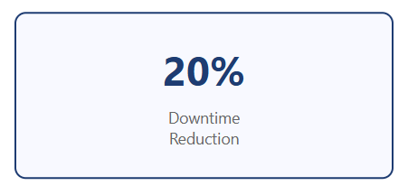
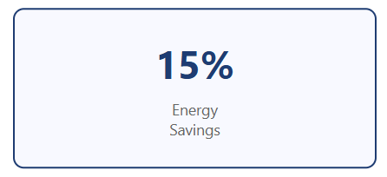
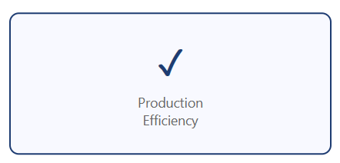
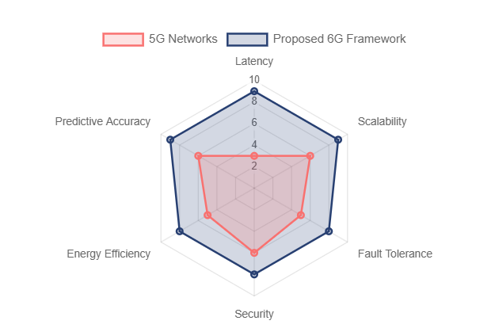


Experimental Results
ICTC 2025
Smart Manufacturing Case Study Results
Performance Metrics Comparison
Key Achievement THz spectrum and IRS-enabled links enable quick fault recovery with enhanced predictive accuracy compared to traditional CPS models

Slide 11
Application Areas
ICTC 2025
Smart Manufacturing
Predictive maintenance, quality control, process optimization, real-time monitoring
Smart Cities
Urban planning, environmental monitoring, public services, resource management
🏭
🏙️
Intelligent Transportation
Autonomous vehicles, traffic management, safety systems, route optimization
🚗
Application Domains
Critical Infrastructure
Power grids, telecommunications, emergency systems, resource allocation
Healthcare Systems
Remote monitoring, surgical robotics, medical equipment synchronization
⚡
🏥

Slide 12
ICTC 2025
Thank You!
Intelligent Networking Lab (INL)
School of Computer Science and Engineering, Chung-Ang University
Seoul, Republic of Korea

